Slide 1

Project Title
MINOR PROJECT-II
AD-608
Problem Statement: Emotion Recognition: Can machines truly read our minds (and emotions) without getting lost in translation
Project Group Number: 07
Group Member Details:
Guide Details: Dr. Vasima Khan
( HOD, Dept. of CSE-AI&DS )
Mahak Mirza | 0187AD211020
Sparsh Sahu | 0187AD211039
Eashan Tiwari | 0187AD211015

Slide 2
Idea/Approach Details
Abstract:
Our project introduces an emotion recognition system that merges machine learning methods, particularly deep learning models, with OpenCV for real-time analysis of facial expressions and voice tone.
The system's objective is to accurately detect and categorize emotions such as happiness, sadness, and anger, providing valuable insights for applications in healthcare, customer service, education, and more.
By combining advanced algorithms and computer vision capabilities, our solution offers a reliable and efficient approach to understanding and responding to human emotions in diverse scenarios.
Describe your idea Solution/Prototype here:
The proposed solution is a real-time emotion recognition system that leverages machine learning, including deep learning models, and OpenCV for processing and analyzing facial expressions and voice tone. This combination enhances the accuracy and reliability of emotion detection, making it suitable for applications in healthcare, customer service, education, and more.

Slide 3





Idea/Approach Details
Technology Used :

Slide 4
Project Requirements
Functional Requirements
Non-Functional Requirements
Preprocessing for Prediction:
The system should preprocess input images as required by the model for accurate emotion prediction.
Emotion Classes for Prediction:
The model should predict emotions from seven predefined classes during evaluation, including happiness, sadness, anger, surprise, fear, neutrality, and disgust.
Real-time Emotion Capture and Prediction:
The system should capture real-time facial expressions and voice tone to perform emotion prediction instantly and accurately.
Performance:
Real-time emotion detection with high accuracy.
User-friendly Interface:
Intuitive design for easy navigation and understanding of emotion prediction results.
Maintainability:
Clear documentation, modular design, and coding standards for easy updates and maintenance.

Slide 5
Project Requirements
Hardware Requirements
Software Requirements
Graphics Processing Unit (GPU)
At least a 4GB
Enables faster training and GPU-accelerated computations.
Random Access Memory (RAM)
Minimum 8 GB RAM
Handles large datasets and trains complex models efficiently.
Operating System (OS)
System compatible with TensorFlow libraries
Ensures compatibility with machine learning frameworks and seamless development.
Python
Open CV
Tensorflow
Keras
VS Code

Slide 6
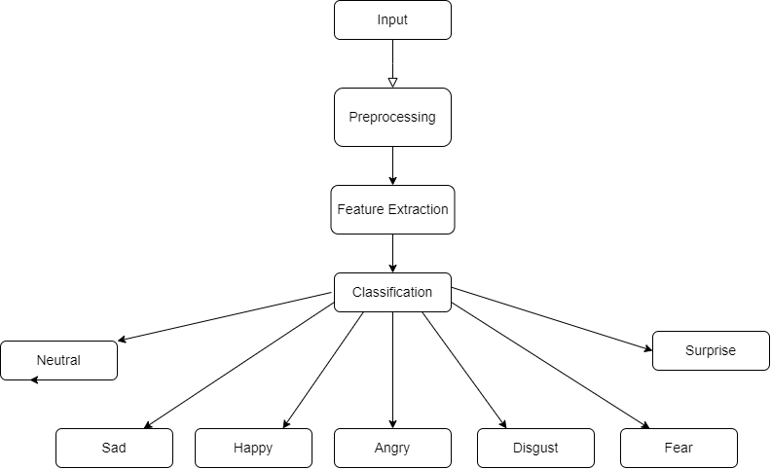
Design
Data flow diagram :-

Slide 7
Design
Dependencies / Show stopper :
Use Cases :
Dependencies:
Availability of labeled emotion data for training machine learning models.
Compatibility with hardware and software requirements, such as GPU support for deep learning computations.
Showstoppers:
Inaccurate or unreliable emotion prediction results, leading to poor user experience and system usability.
Lack of user acceptance or adoption due to complex user interface or inadequate accessibility features.
Customer Service Enhancement
Healthcare Application
Education and Learning
Entertainment and Gaming
Market Research and Advertising
Human-Computer Interaction

Slide 8
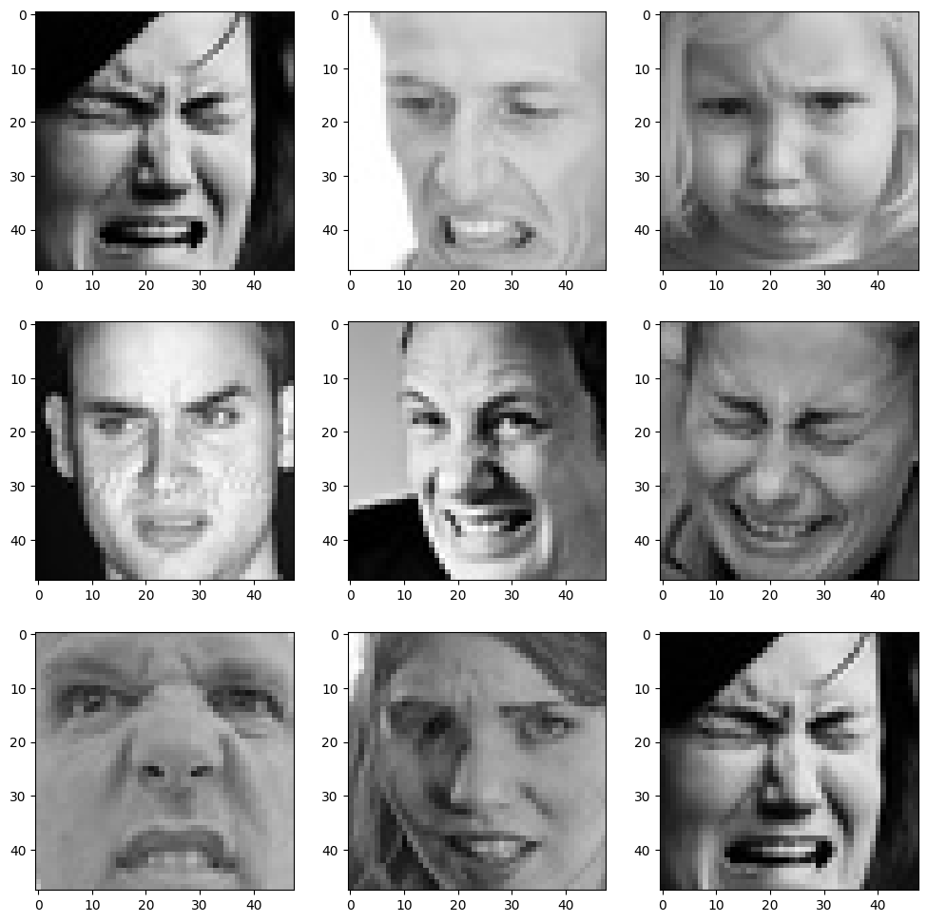
Project Screenshots
Fig:- Dataset Images

Slide 9
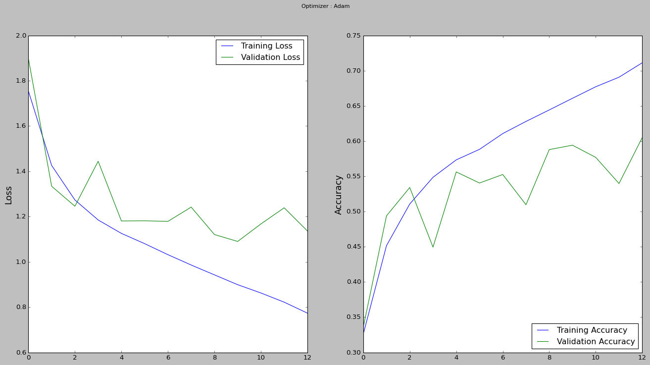
Project Screenshots
Fig:- Training And Validation Accuracy

Slide 10
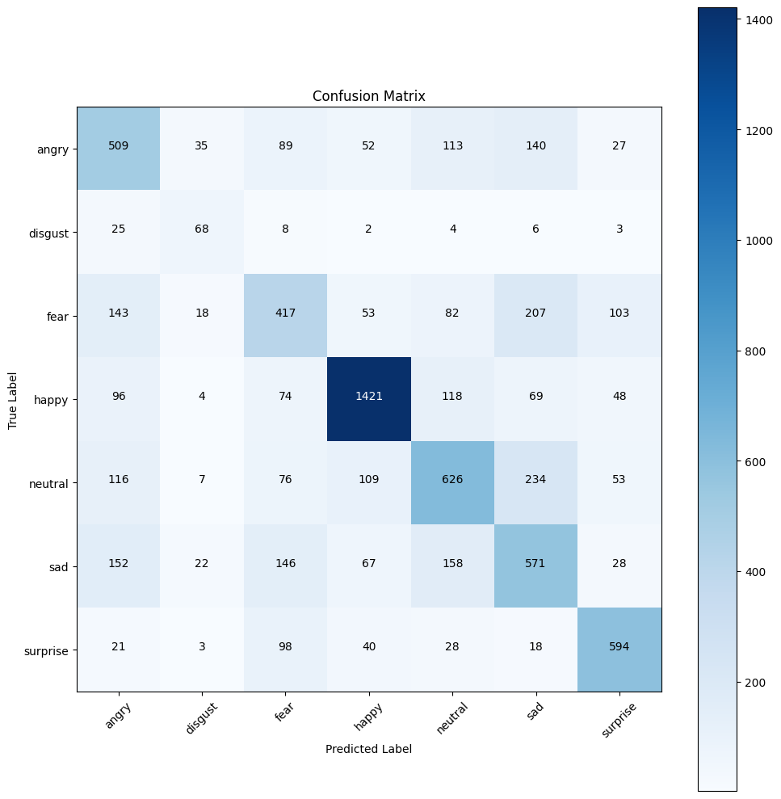
Project Screenshots
Table:- Confusion Matrix

Slide 11


